Slide 1
Severe Intracranial Hemorrhage as the Initial Presentation of B-Lymphoblastic Leukemia
Bradley W. Emmerich, MD
Matthew T. Singh, MD
Jeffrey S. Jones, MD

Slide 2
Introduction
Acute lymphoblastic leukemia (ALL) is a cancer of the lymphoid line of blood cells.
B-lymphoblastic leukemia (B-ALL) is primarily a disease of children, with >75% of cases occurring in children less than 6 years old.
There is a second peak of incidence in adults greater than 60 years old.
The early signs of ALL are often nonspecific such as fatigue, fever, night sweats, and unintentional weight loss.

Slide 3
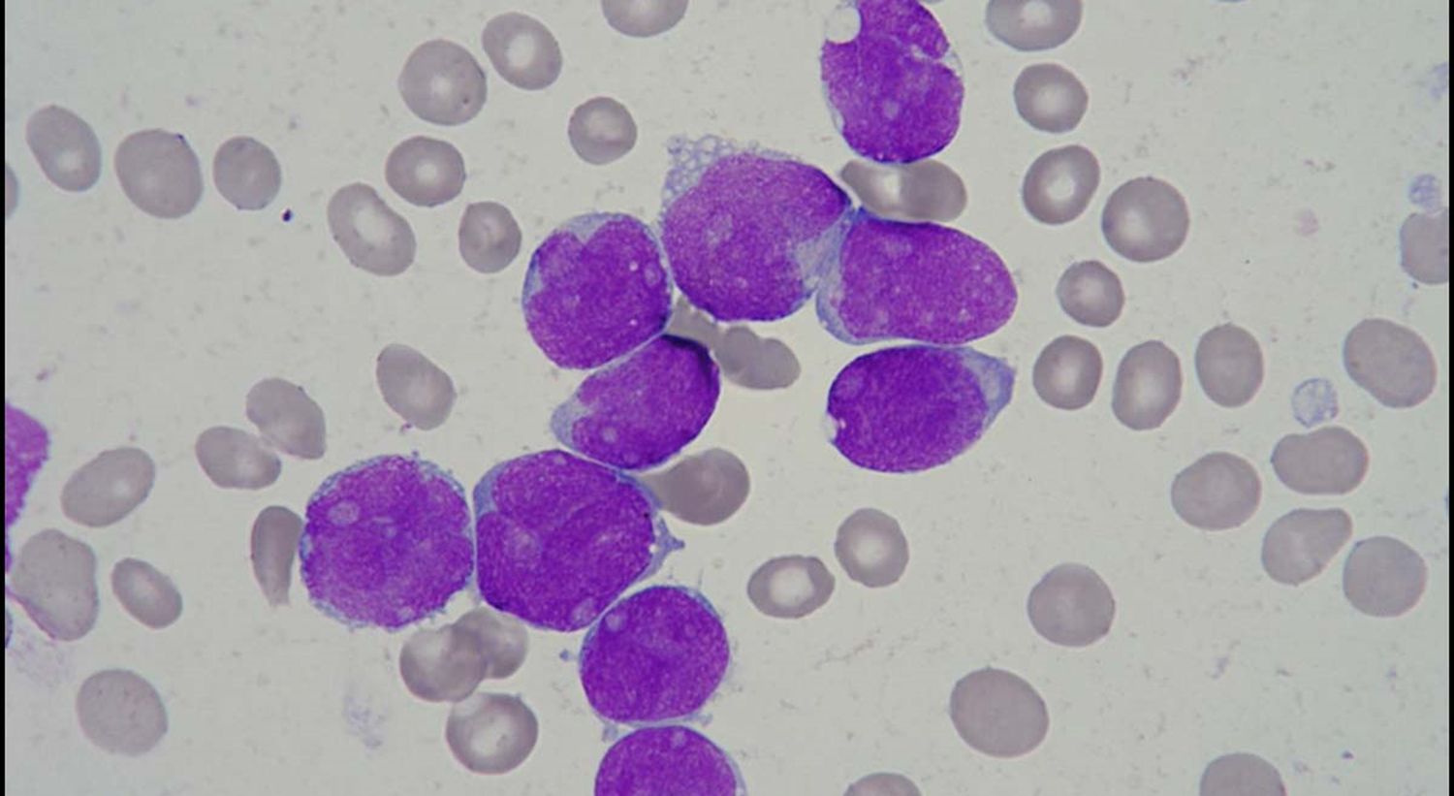

Slide 4
Introduction
While infection is the most common cause of death in patients with leukemia, coagulopathy may occur in the setting of thrombocytopenia, platelet dysfunction, coagulation factor deficiency, and hyperleukocytosis.
In this report, we discuss the case of a previously healthy female patient, who rapidly developed fatal intracranial hemorrhage (ICH) as a result of undiagnosed B-ALL

Slide 5
Case Description
A 35-year-old female with a history of depression presented to the emergency department (ED) with migraine and altered mental status.
Upon emergency medical services (EMS) evaluation, the patient was noted to have right-sided deficits, so she was activated as a prehospital stroke activation.
Throughout transport, the patient’s mental status continued to decline.

Slide 6
Case Description
At the time of initial exam in the ED, she was able to respond to yes/no questions and follow simple commands.
Her deficits included dilated left pupil, right upper and lower extremity hemiplegia, and right-sided sensory deficits. Her initial NIHSS was 24.
She was taken emergently from the resuscitation bay to the radiology suite to facilitate stroke CT imaging.
Imaging revealed a large ICH in the left hemisphere.

Slide 7
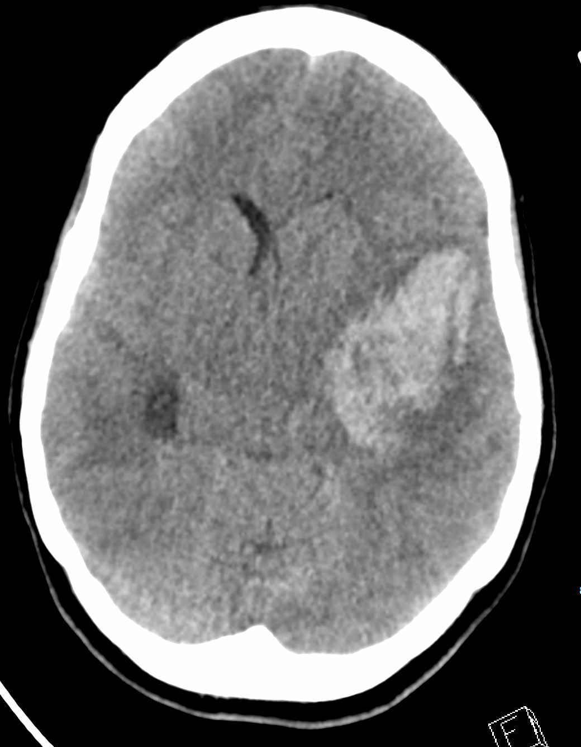
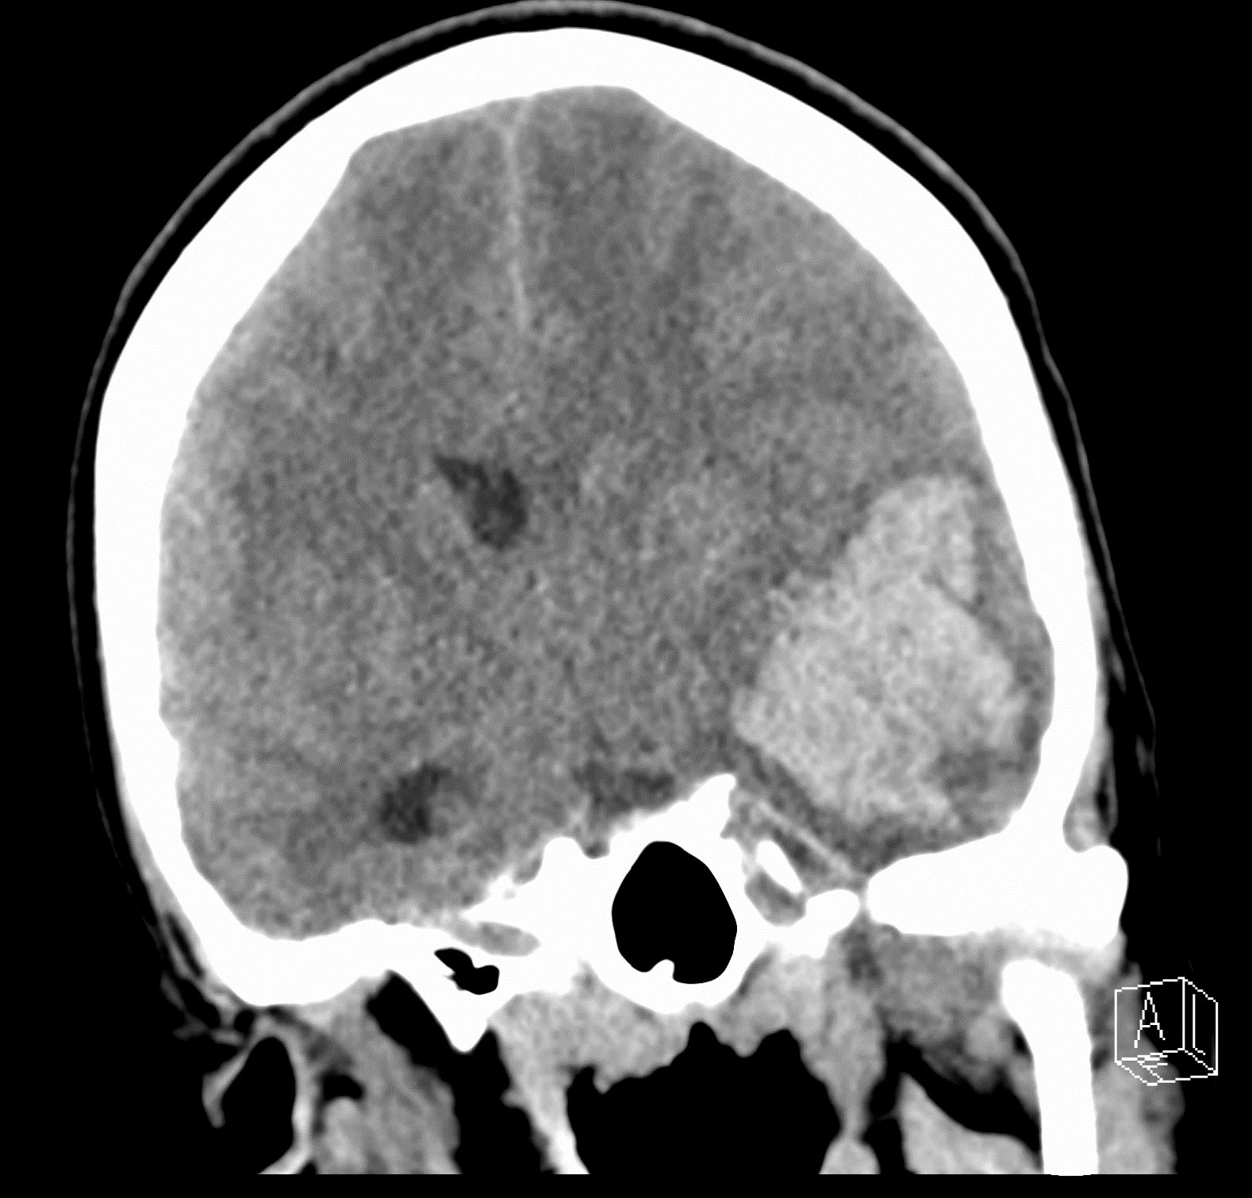
Notes:
6.1 cm intraparenchymal hemorrhage centered in the left temporal lobe with extension into the left lateral ventricle. There is 7 mm of midline shift to the right with effacement of the basal cisterns.

Slide 8
Intervention
The patient’s mental status declined further, and she was no longer able to respond to questions or follow commands.
She began having flexor posturing in the left upper extremity and was subsequently intubated.
CBC revealed a marked leukocytosis of 638,150, hemoglobin of 5.1, and undetectable platelets.
The pathologist reviewed a peripheral smear and described blast-type mononuclear cells with slight size variation, most suggestive of acute leukemia.

Slide 9
Intervention
Cytogenic and FISH findings were consistent with translocation of the MLL/11q23 gene region consistent with B-ALL.
She was taken for emergent decompressive hemicraniectomy and admitted to the neurology intensive care unit (NICU).
Throughout her time in the NICU, she continued to have neurological decline and was ultimately transitioned to comfort care where she died surrounded by her family on hospital day seven.

Slide 10
Discussion
Prompt recognition of stroke-like symptoms in the prehospital environment activates the appropriate resources and improves downstream efficiency in the ED.
Real-time evaluation of a non-contrast CT head allows emergency physicians to identify life-threatening ICH and seek emergent neurosurgery consultation.

Slide 11
Discussion
Medical management of acutely elevated intracranial pressure can be accomplished with hyperventilation, hypertonics/hyperosmotics, and head of bed elevation.
Reversal of coagulopathy with platelets, fresh frozen plasma, and cryoprecipitate can be initiated while awaiting neurosurgical intervention.

Slide 12
Conclusion
This case is unique because it represents massive ICH as the sentinel event for a patient with previously undiagnosed B-ALL, which is rarely reported in the literature.
Patients with ALL may access the ED for care throughout the course of their disease; they may be diagnosed in the ED, or they may present with infection, chemotherapy-induced nausea/vomiting, or hemorrhage.
In the setting of massive ICH, a strong knowledge of downstream hospital care can allow for prompt ED intervention and give the patient the best chance at a positive outcome.

Slide 13
References
Bhojwani, Deepa, Jun J. Yang, and Ching-Hon Pui. "Biology of childhood acute lymphoblastic leukemia." Pediatric Clinics 62.1 (2015): 47-60.
Redaelli, A., et al. "A systematic literature review of the clinical and epidemiological burden of acute lymphoblastic leukaemia (ALL)." European journal of cancer care 14.1 (2005): 53-62.
Dores, Graça M., et al. "Acute leukemia incidence and patient survival among children and adults in the United States, 2001-2007." Blood, The Journal of the American Society of Hematology 119.1 (2012): 34-43.
Inaba, Hiroto, Mel Greaves, and Charles G. Mullighan. "Acute lymphoblastic leukaemia." The Lancet 381.9881 (2013): 1943-1955.
Kiem Hao, Tran, et al. "Causes of death in childhood acute lymphoblastic leukemia at Hue Central Hospital for 10 years (2008-2018)." Global pediatric health 7 (2020): 2333794X20901930.

Slide 14
Bradley W. Emmerich, MD
bradley.emmerich@corewellhealth.org
Matthew T. Singh, MD
Matthew.singh@corewellhealth.org
Jeffrey S. Jones, MD
jeffrey.jones@corewellhealth.org
Michigan State University College of Human Medicine
Department of Emergency Medicine
Grand Rapids, MI

